Slide 1
Distributed Edge Computing
for Real-time Drip Irrigation
Monitoring System
Tasnim Fuyara Chhoan (23366035)
Abrar Al Sayem (18201194)
Ripa Sarkar(23366009)
Ashika Islam (22273013)
Mehnaz Ara Faizul (ST)
Humaion Kabir Mehedi (RA)
Team 21

Slide 2
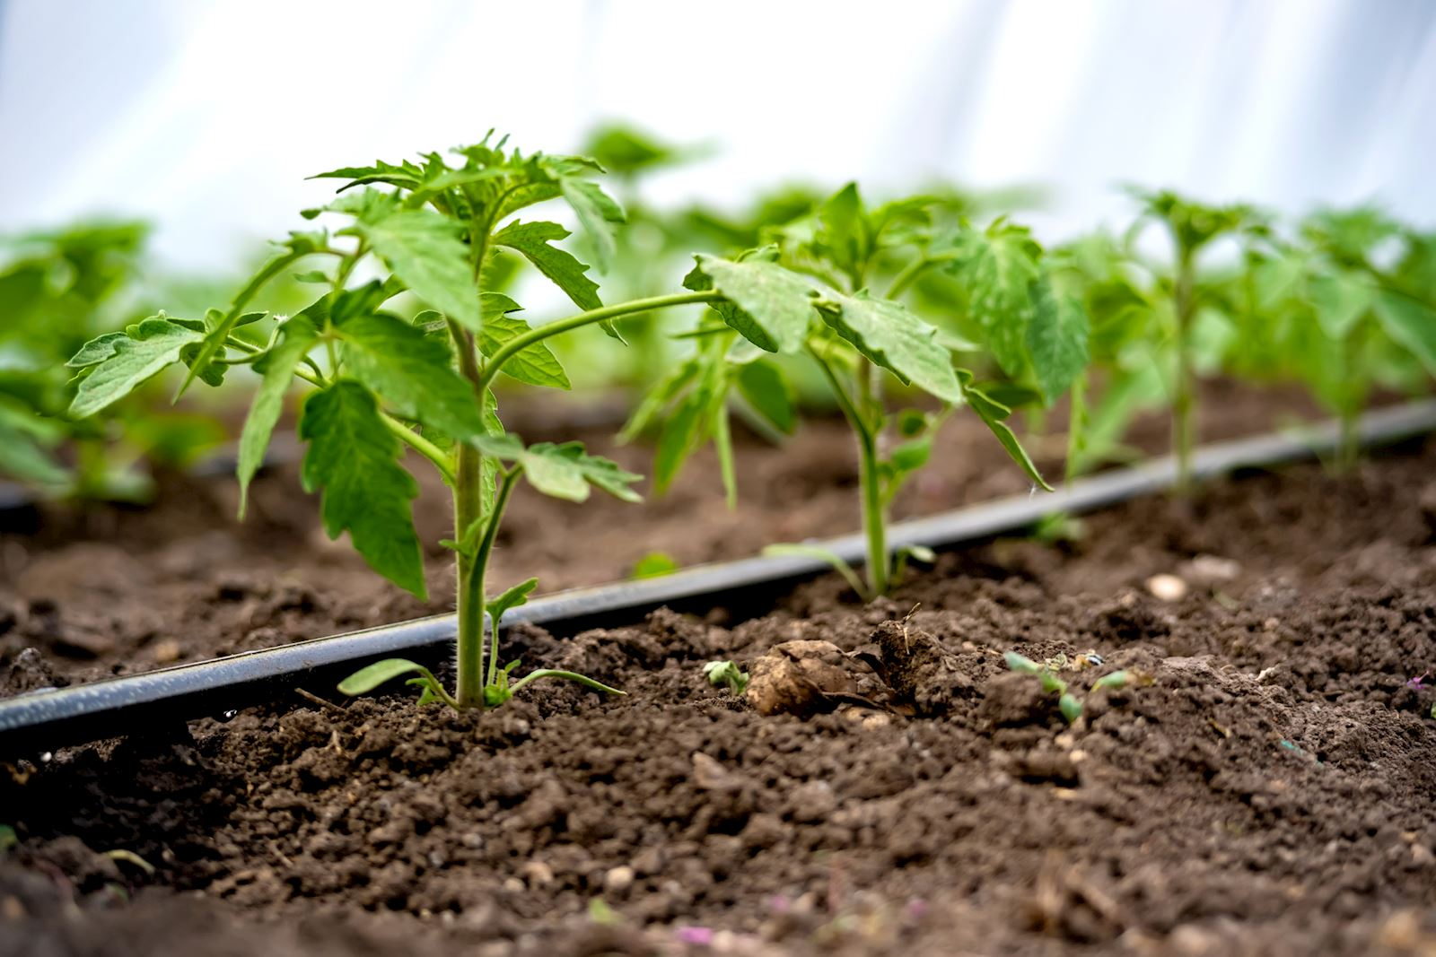
Table of Contents
Introduction
Background
Research Idea
Edge Computing in DI
Monitoring and Data Analysis
Our Approach
Potential challenges
Conclusion

Slide 3
Introduction
Global warming and population growth place unprecedented strain on water resources.
Precision irrigation, utilizing cloud based distributed edge, is vital for sustainable agriculture.
System uses sensors, and raspberry pi to monitor and control variables like soil moisture, water usage, rainfall, evapotranspiration, and more.
Successful applications include water quality management, smart irrigation systems, and data analytics.
Data-driven predictive modeling enhances decision-making for optimized water usage and increased efficiency in agriculture.

Slide 4
Background
[1] The paper introduces a distributed IoT system for precise, real-time irrigation in agriculture, addressing the inefficiencies of traditional methods. Utilizing sensing devices, Azure cloud, and mobile devices, the system is scalable and responsive, with potential applications beyond irrigation. Limitations include untested real-world applicability and a focus on soil moisture. Nevertheless, the paper highlights the transformative potential of IoT systems in agriculture, offering adaptability for integration with other smart farming technologies and advancements in AI for broader agricultural needs.
[2] This paper investigates communication security in smart grid distribution, with a focus on Home Area Networks and Neighbourhood Area Networks. The methodology delves into understanding security objectives, threats, feasibility, and practical issues within these networks. The study underscores the ongoing necessity for discussions and implementations to fortify cyber security in the dynamic landscape of the electric grid, aiming to foster consumer trust in this transformative process.

Slide 5
Background
[3] The complementarity of edge computing with the cloud to reduce latency and enhance overall performance. It introduces an edge computing framework for real-time monitoring, shifting computation from centralized cloud to edge servers. To optimize this framework, the paper formulates a scheduling problem and proposes a simulated annealing-based heuristic algorithm. Real-world experiments and simulations demonstrate that the proposed framework can boost monitoring frame rate by up to 10 times and reduce detection delay by up to 85% compared to cloud monitoring solutions.
[4] The paper “Ground-Level Mapping and Navigating for Agriculture Based on IoT and Computer Vision” introduces a cutting-edge autonomous agri-mapping system, driven by the need to address labor shortages and enhance productivity. Utilizing Mesh-SLAM and IoT, the three-layer system ensures scalability, cost-effectiveness, and precise mapping. Key contributions include the innovative Mesh-SLAM algorithm and IoT flexibility, aiming to improve agricultural efficiency and sustainability by optimizing crop management and reducing labor demands.

Slide 6
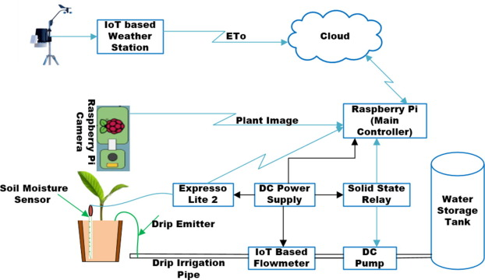
Research Idea
This project aims to observe and manage computation in distributed edge systems for Drip Irrigation (DI), with monitoring facilitated through cloud computing. Our system will observe data processing, latency, bandwidth etc considering variables like soil moisture, water usage, rainfall, evapotranspiration, and more.

Slide 7
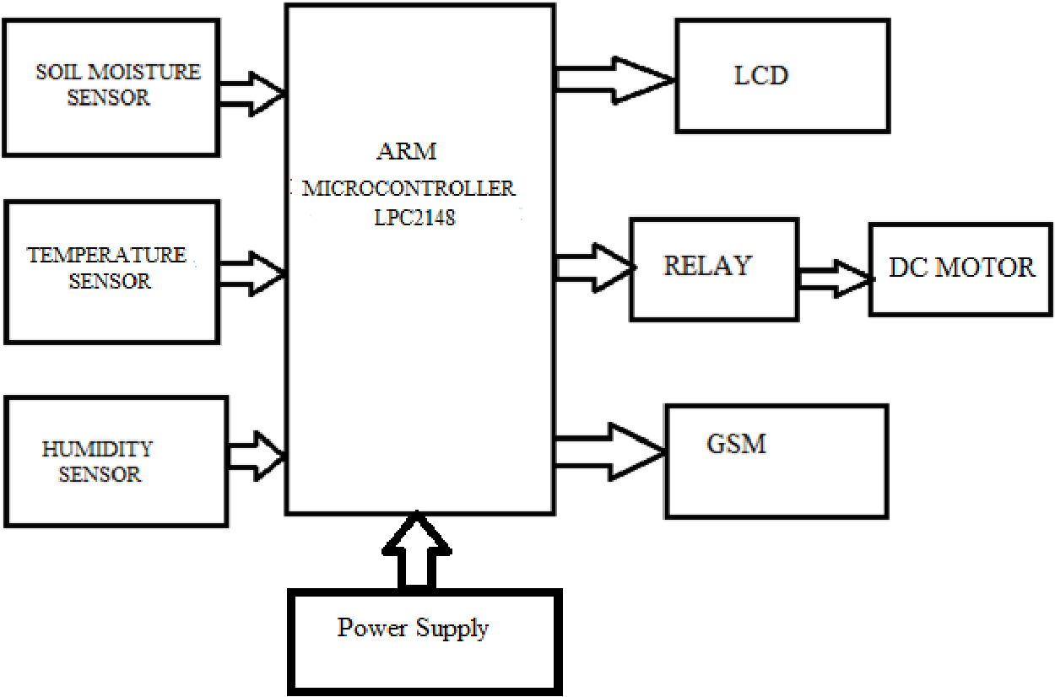
Edge Computing In DI
Local Data Processing
Real-time Decision Making
Reduced Latency

Slide 8
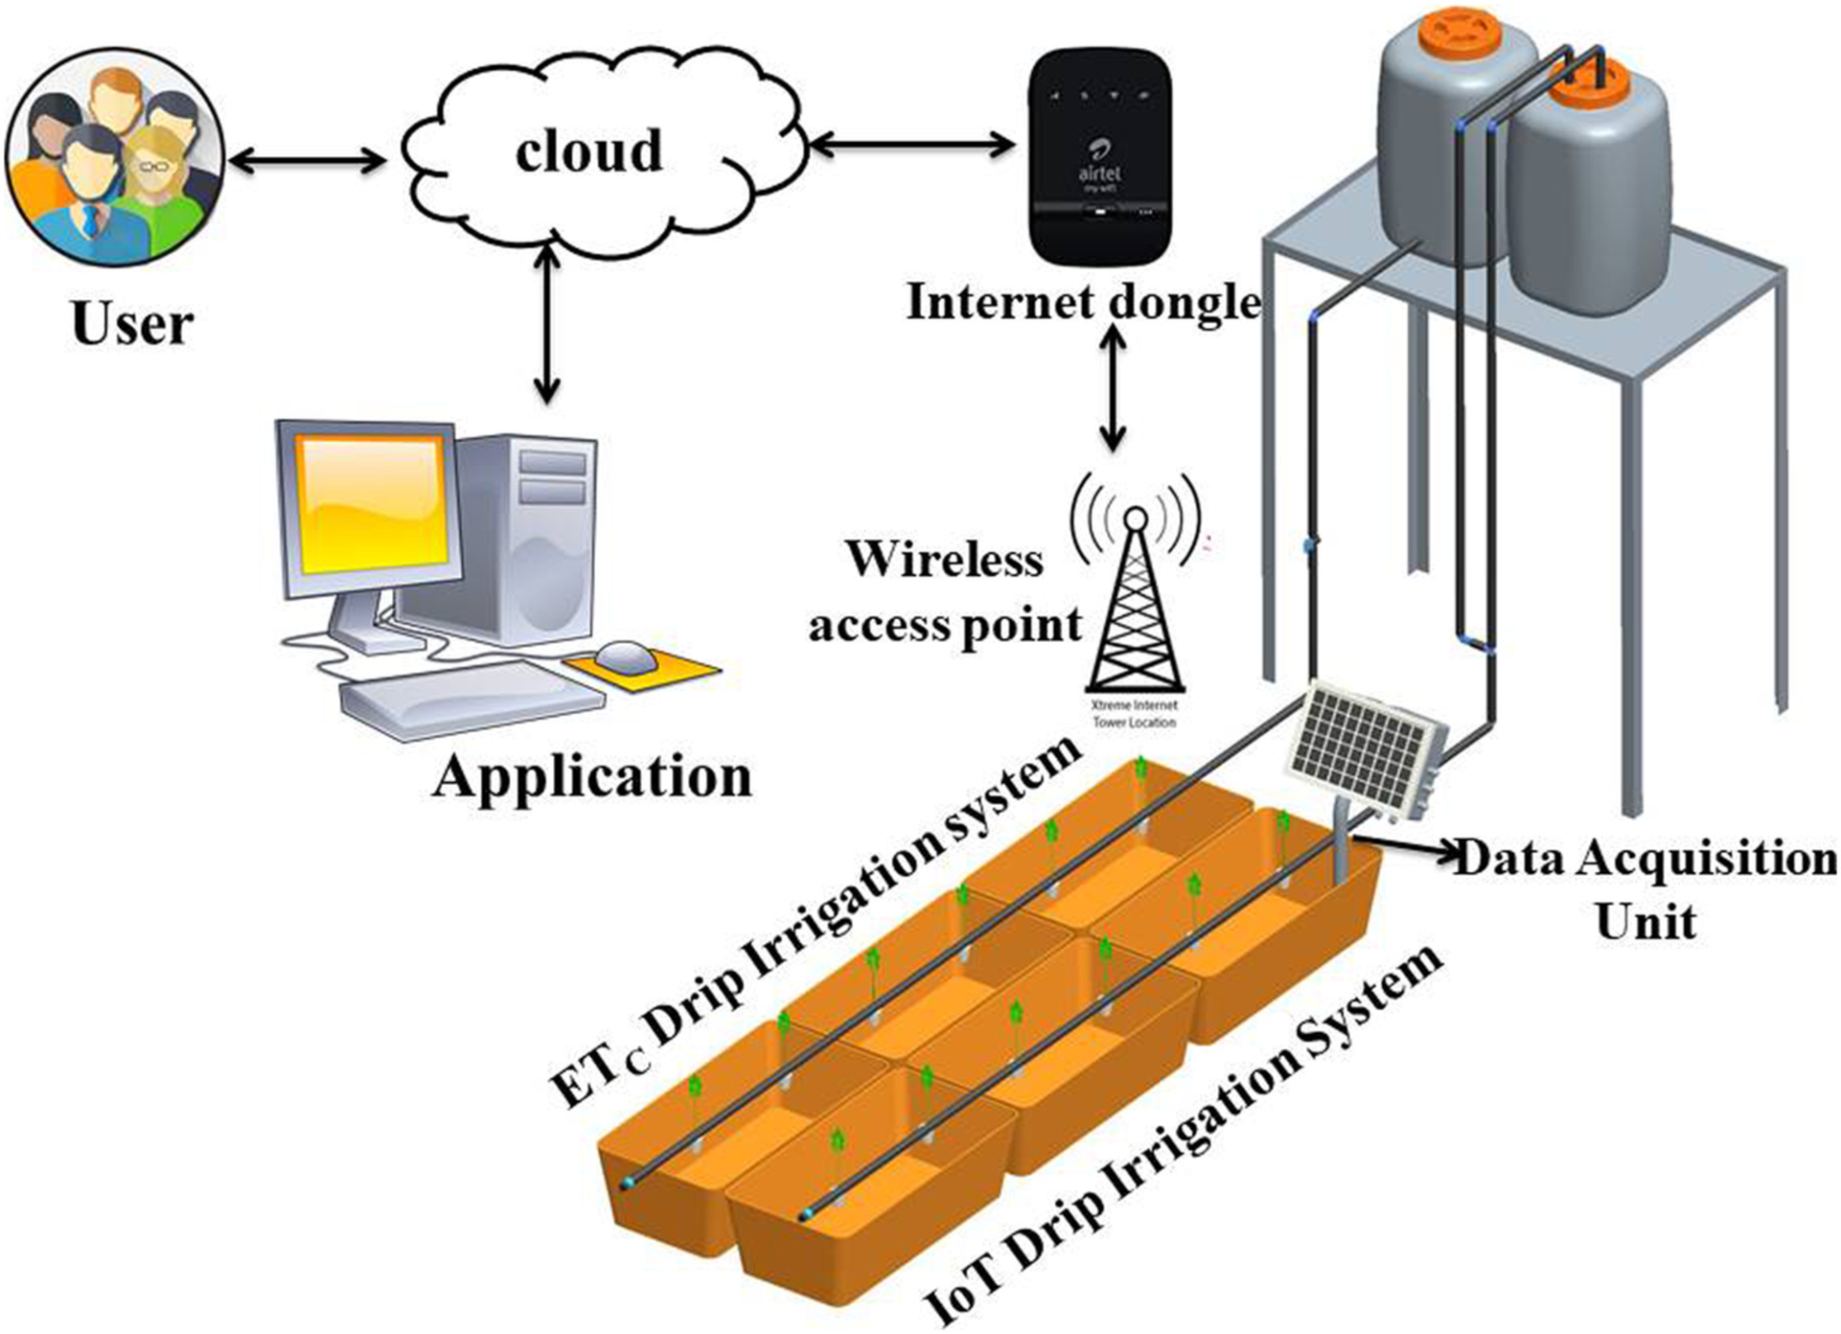
Cloud Monitoring and Data Analysis
Centralized Oversight
Data Aggregation and Analysis
Remote Accessibility

Slide 9
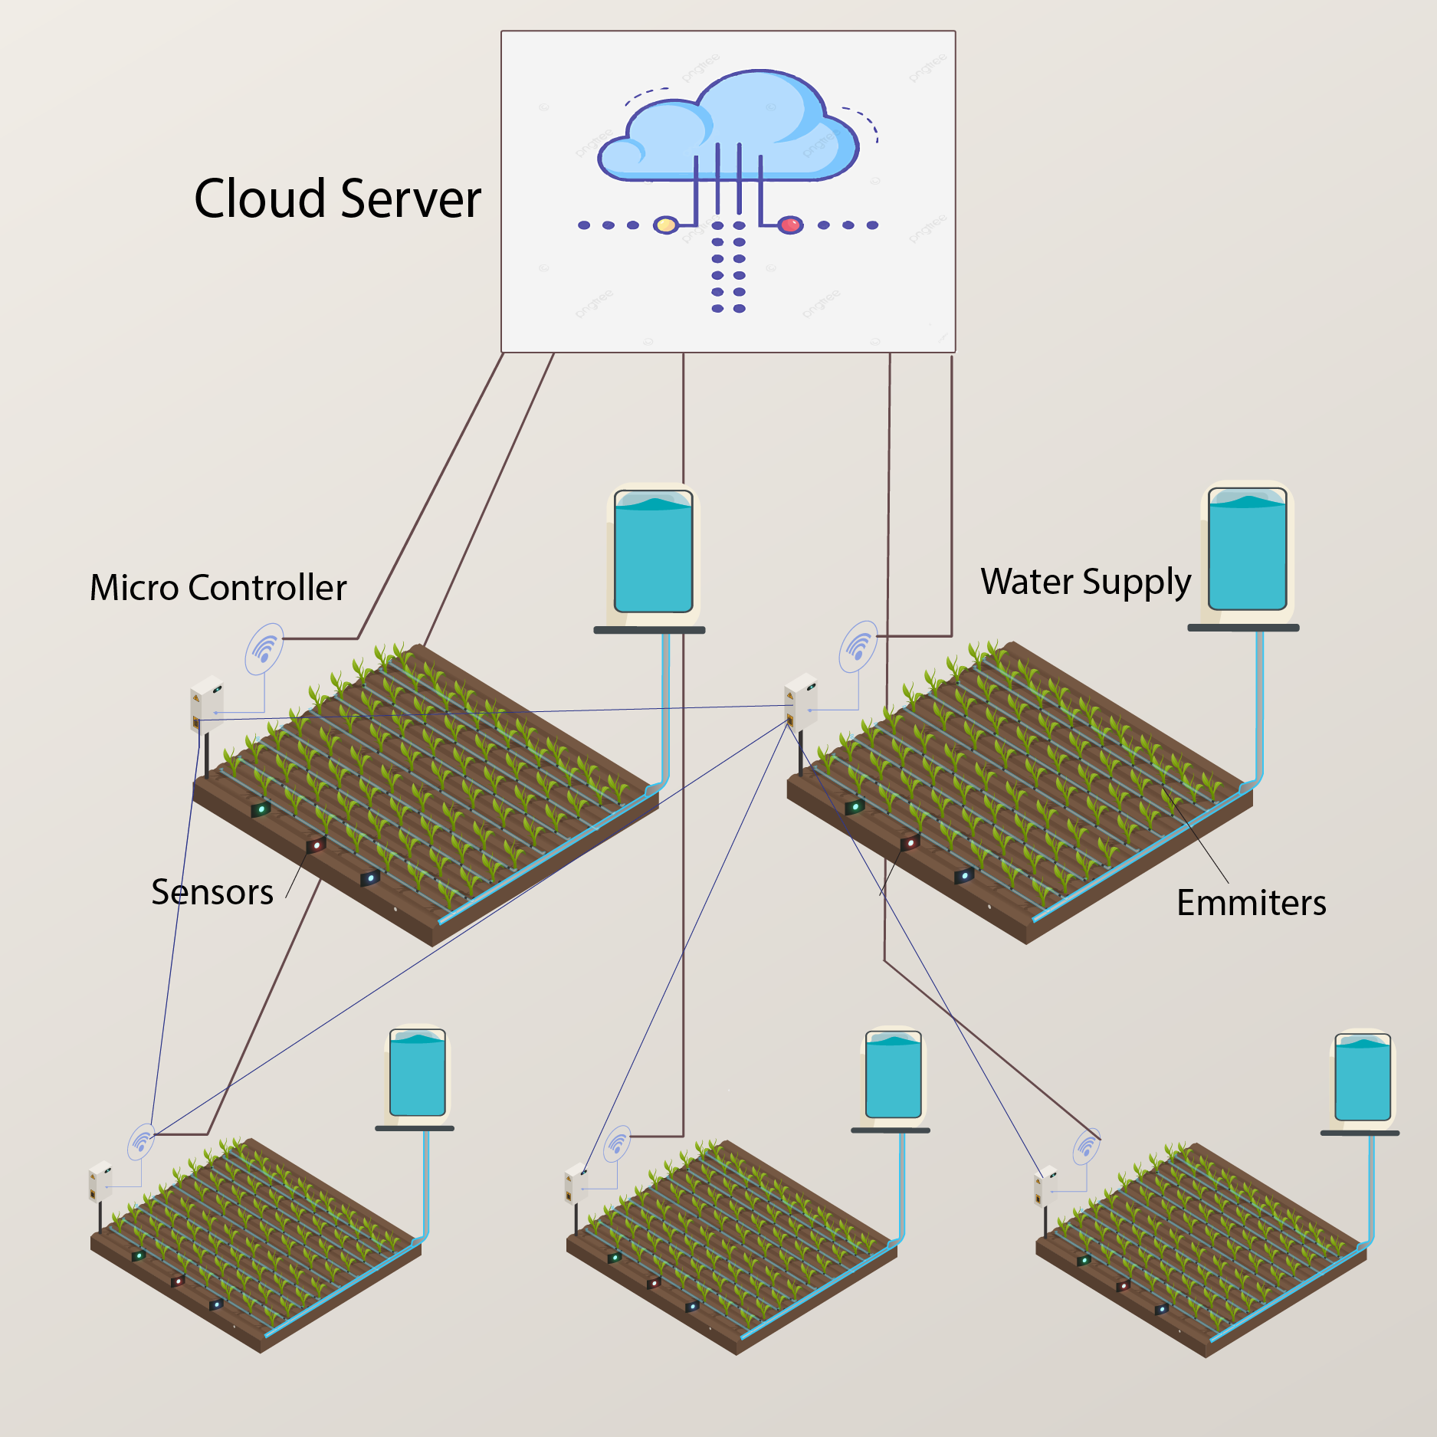
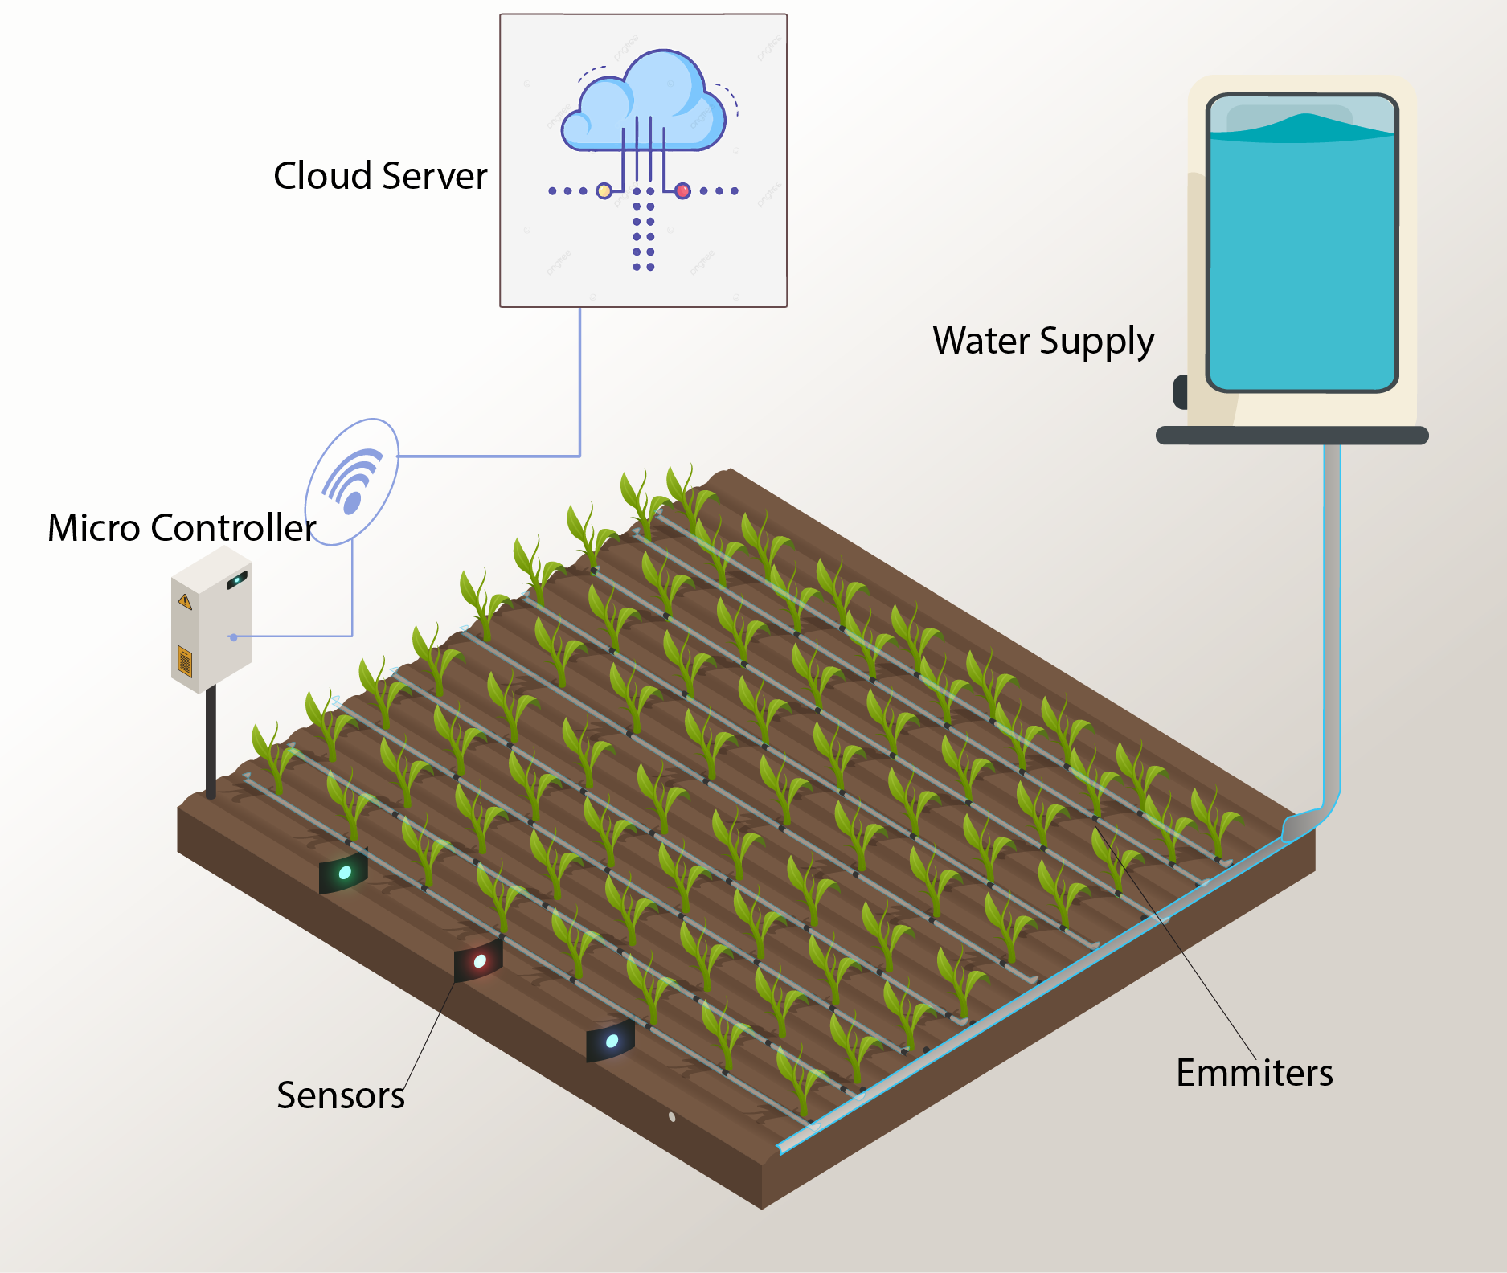
Our Approach

Slide 10
Edge Node Processing
Latency and Response Time
System Scalability
Observations
Algorithmic Performance
Energy Efficiency

Slide 11
Potential challenges
Edge and Cloud Integration Complexity
Data Management and Processing
Network Connectivity
Scalability and Adaptability
More Advanced Algorithms (ML/DL)

Slide 12
Conclusion
Drip irrigation system simulation has emerged as a powerful tool for optimizing water use efficiency in agriculture.
Enabling real-time data processing at the edge for optimal water management in agriculture.
Key challenges, including technical integration, data management, network reliability, and cost considerations
Integrating advanced features, such as Machine learning and Deep Learning, can further improve efficiency and sustainability.

Slide 13
References
[1] Bou-Harb, E., Fachkha, C., Pourzandi, M., Debbabi, M., & Assi, C. (2013). Communication security for smart grid distribution networks. IEEE Communications Magazine, 51(1), 42-49. https://doi.org/10.xxxx/yyyy
[2] Bou-Harb, E., Fachkha, C., Pourzandi, M., Debbabi, M., & Assi, C. (2013, January). Communication security for smart grid distribution networks. IEEE Communications Magazine, 51(1), 42-49. https://doi.org/10.xxxx/yyyy
[3] Y. Huang, Y. Lu, F. Wang, X. Fan, J. Liu, and V. C. M. Leung, "An Edge Computing Framework for Real-Time Monitoring in Smart Grid," 2018 IEEE International Conference on Industrial Internet (ICII), 18 November 2018, 978-1-5386-7771-1/18/$31.00.
[4] Wei Zhao, Xuan Wang, Bozhao Qi, & Troy Runge. (2020). Ground-Level Mapping and Navigating for Agriculture Based on IoT and Computer Vision. API (Digital Object Identifier 10.1109/ACCESS.2020.3043662).

Slide 14
THANK YOU

